Slide 1
Program Security

Slide 2
Program Security
What is exactly a secure program?
  Different people may give different answers
  In general, a secure program should behave as their designers intended or uses expected
Program security flaws
  Unexpected program behavior
  Two classes
    Inadvertent human errors
    Intentionally induced flaws
    Both types can cause serious damages

Slide 3
Inadvertent human errors(Non-malicious Program
Errors)
Common non-malicious program errors
  Buffer overflows
  Incomplete mediation
  Time-of-check to time-of-use errors

Slide 4
Buffer Overflows
A buffer is a space in which data can beheld
  A buffer is finite
Buffer overflow
  Out of bound use of the buffer
Example
    char sample[10];
    for (int i=0; i<=9; i++)
    sample[i]=‘A’;
    sample[10]=‘B’;

Slide 5
Buffer Overflows
The techniques to exploit a buffer overflow vulnerability vary per architecture, operating system and memory region
There are two different techniques in use
– Stack-based exploitation
– Heap-based exploitation

Slide 6
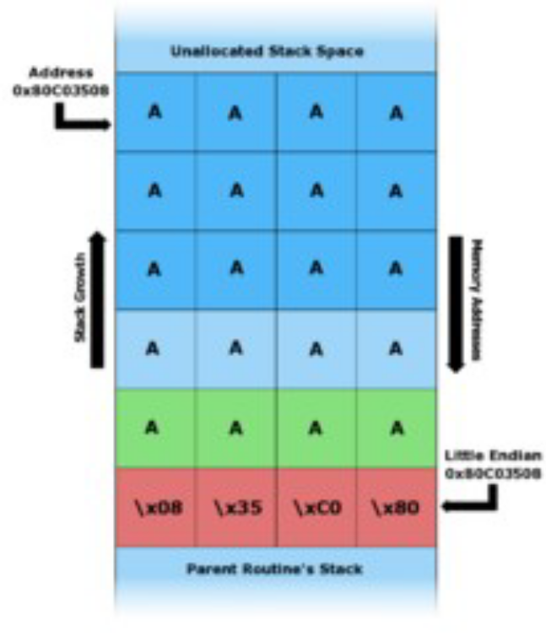
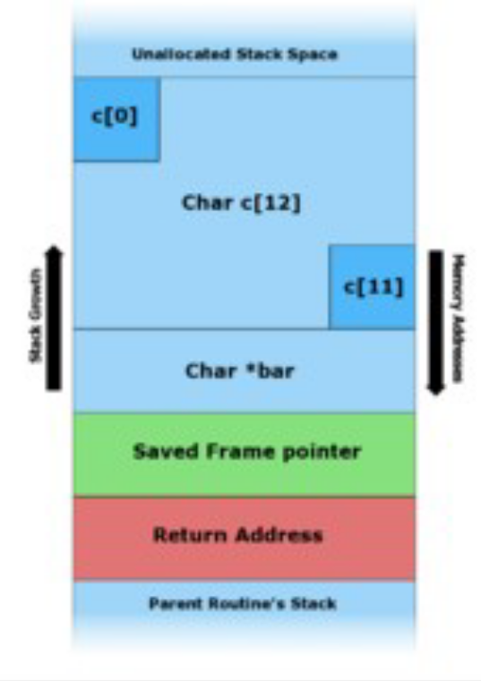
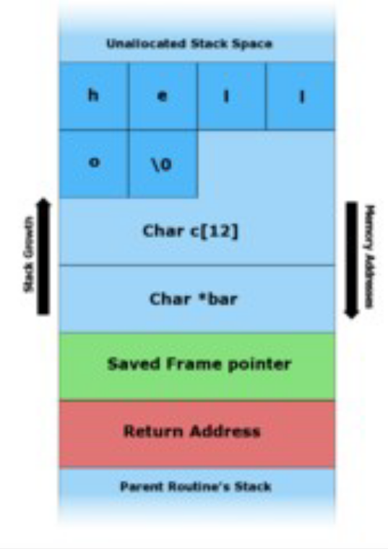
An Example of Stack BufferOverflow
  #include <string.h>
  void foo (char *bar) {
  char c[12];
  strcpy(c, bar); // no bounds checking...
  }
  int main (int argc, char **argv)
  {
  foo(argv[1]);
  }
The program stack in foo() with various inputs
"hello" is the first command line argument
"A A A A A A A A A A A A A A A A A A A A \x08 \x35\ xC0\ x 80" is the first command line argument.
Before data is copied.
In an actual stack buffer overflow exploit the string of "A"'s would instead be shell code suitable to the platform and desired function
If the exploited program had special privileges then the attacker could use this vulnerability to gain super user privileges on the affected machine

Slide 7
Buffer overflow protection
Canaries
  canary are known values that are placed between a buffer and control data on the stack to monitor buffer overflows.
Bounds Checking
  a compiler-based technique that adds run-time bounds information for each allocated block of memory
  Eg. Java use bound checking
Tagging
  tagging the memory of buffer as data memory
  Execution from data memory is illegal

Slide 8
Incomplete mediation
This occurs when access input data is not checking
example http://www.somesite.com/subpage/userinput.asp?parm1=(808)555-1212&parm2=2009Jan17
The two parameters look like a telephone number and a date. Probably the client's (user's) web browser enters those two values in their specified format for easy processing on the server's side. What would happen if parm2 were submitted as 1800Jan01? Or 800Feb30? Or 2048Min32? Or 1Aardvark2Many?
Something would likely fail.
One possibility is that the system would fail terribly, with a routine's failing on a data type error as it tried to handle a month named "Min" or even a year (like 1800) that was out of range.
Another possibility is that the receiving program would continue to execute but would generate a very wrong result.
(For example, imagine the amount of interest due today on a billing error with a start date of 1 Jan 1800.) Then again, the processing server might have a default condition, deciding to treat 1Aardvark2Many as 3 July 1947. The possibilities are endless.

Slide 9
Prevention
Use strict validation for input data
programmer in the examples above may have written code to check for correctness on the client's side (that is, the user's browser).
The client program can search for and screen out errors.
Or, to prevent the use of nonsense data, the program can restrict choices only to valid ones.
  For example, the program supplying the parameters might have solicited them by using a drop-down box or choice list from which only the twelve conventional months would have been possible choices.
Similarly, the year could have been tested to ensure that the value was between 1995 and 2015, and date numbers would have to have been appropriate for the months in which they occur (no 30th of February, for example).
Using these verification techniques, the programmer may have felt well insulated from the possible problems a careless or malicious user could cause

